Slide 1
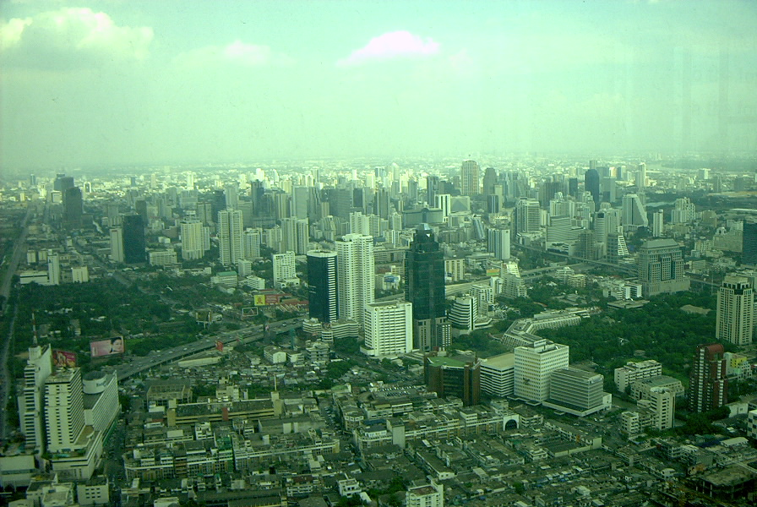
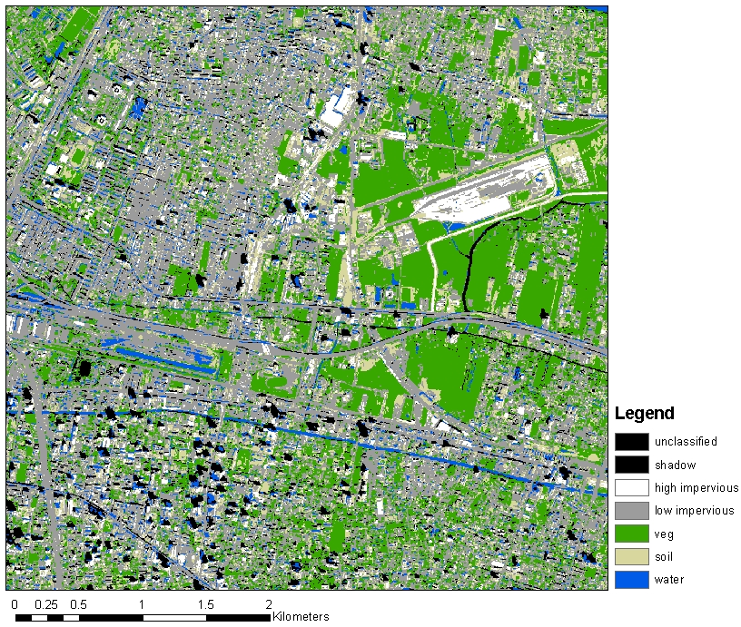
Working with remote sensing image using R

Slide 2
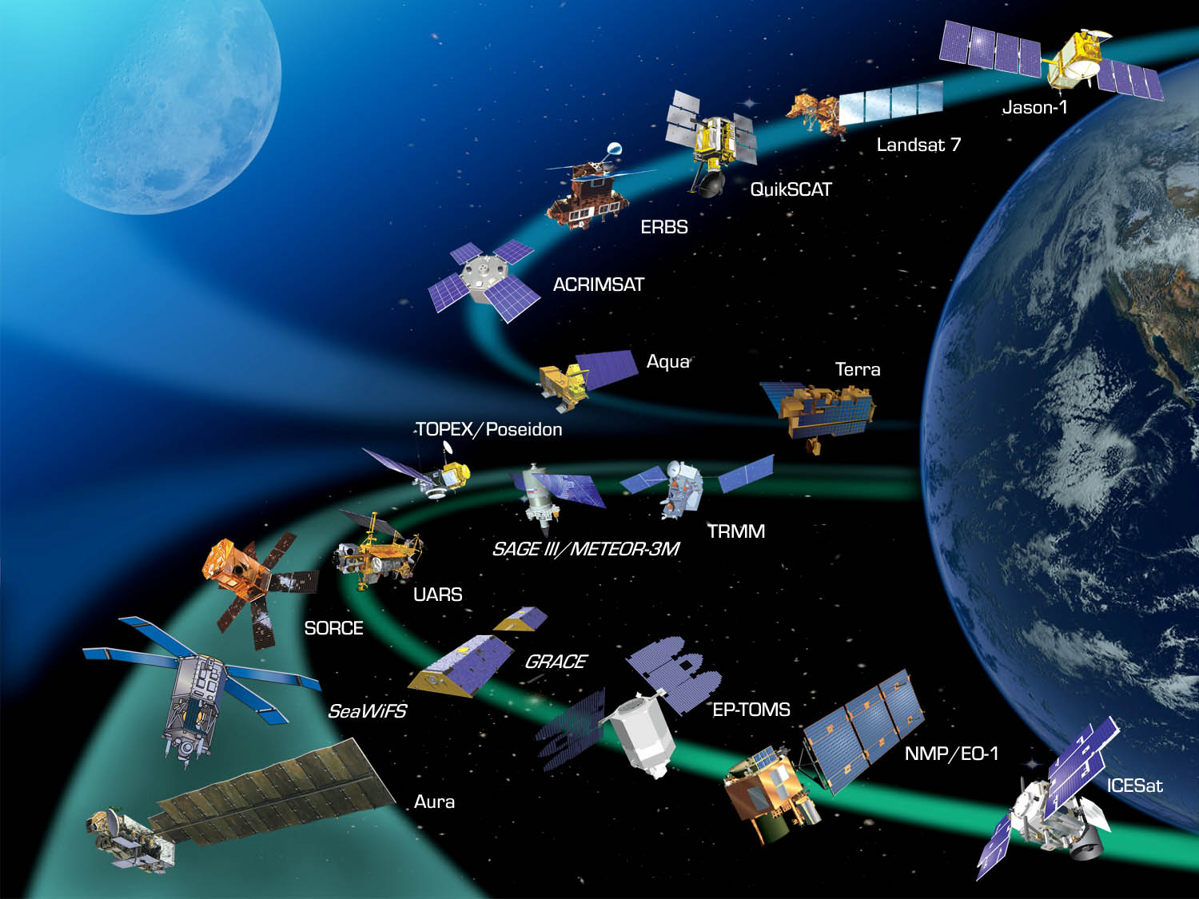
NASA Earth Observatories
Number of Satellites?
2500+

Slide 3

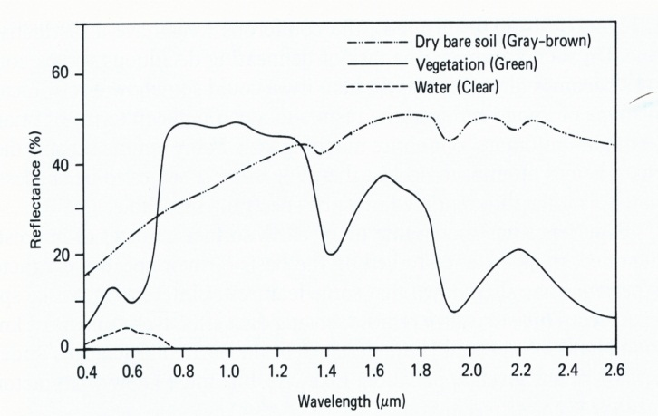
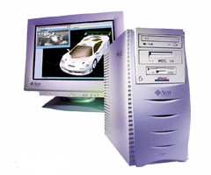
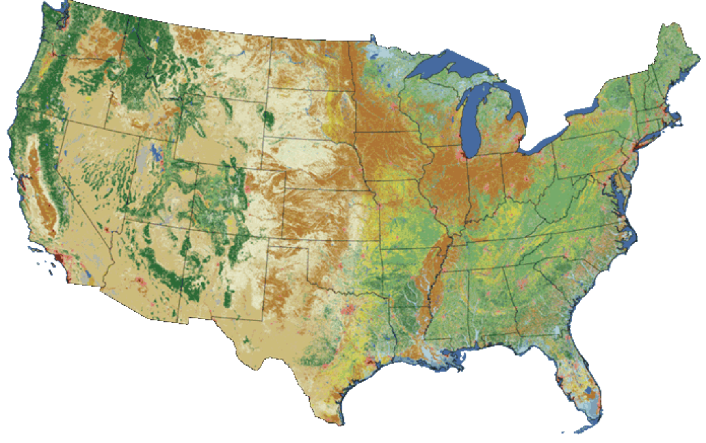
Remote Sensing Data Analysis
Land Cover map: use of remote sensing techniques
Notes:
definitions of categories and data collection methods by source agencies, incomplete data coverage, varying data age, and employment of incompatible classification systems

Slide 4
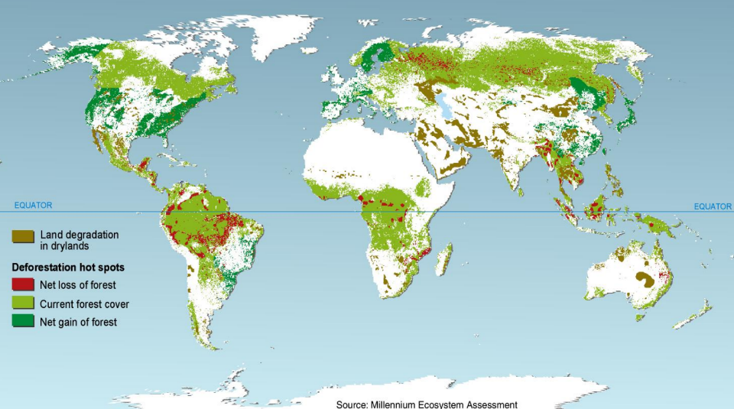
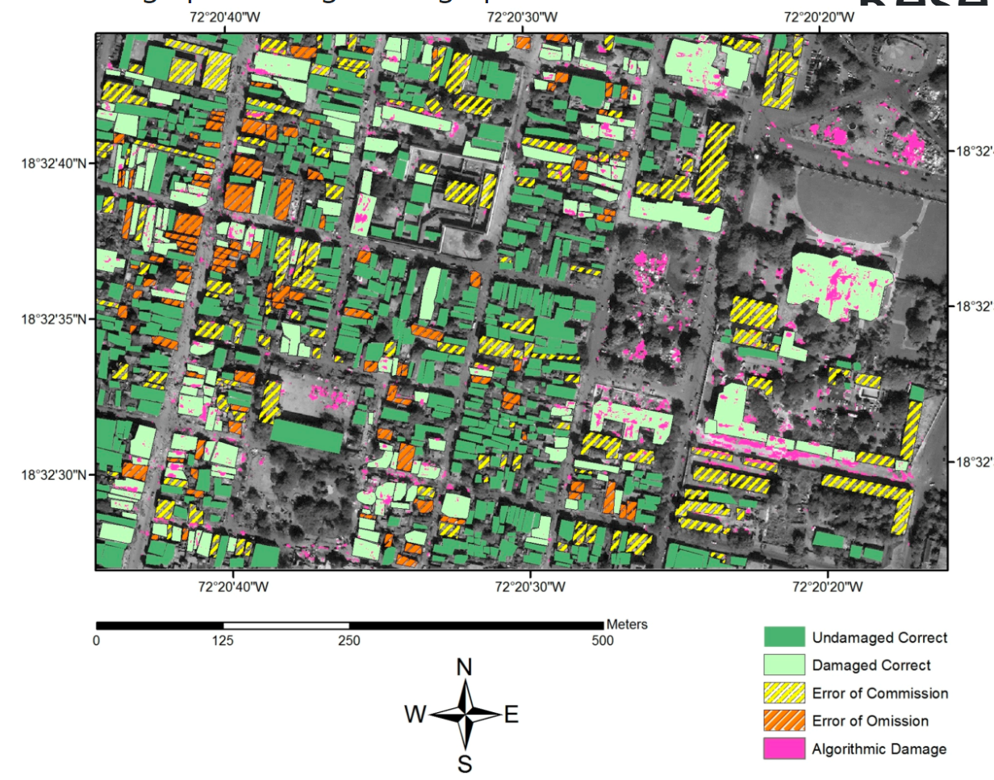
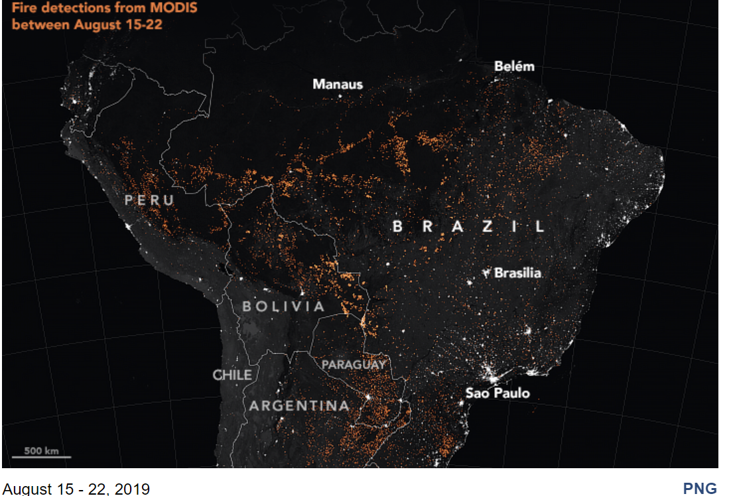
Remote Sensing-derived map products

Slide 5
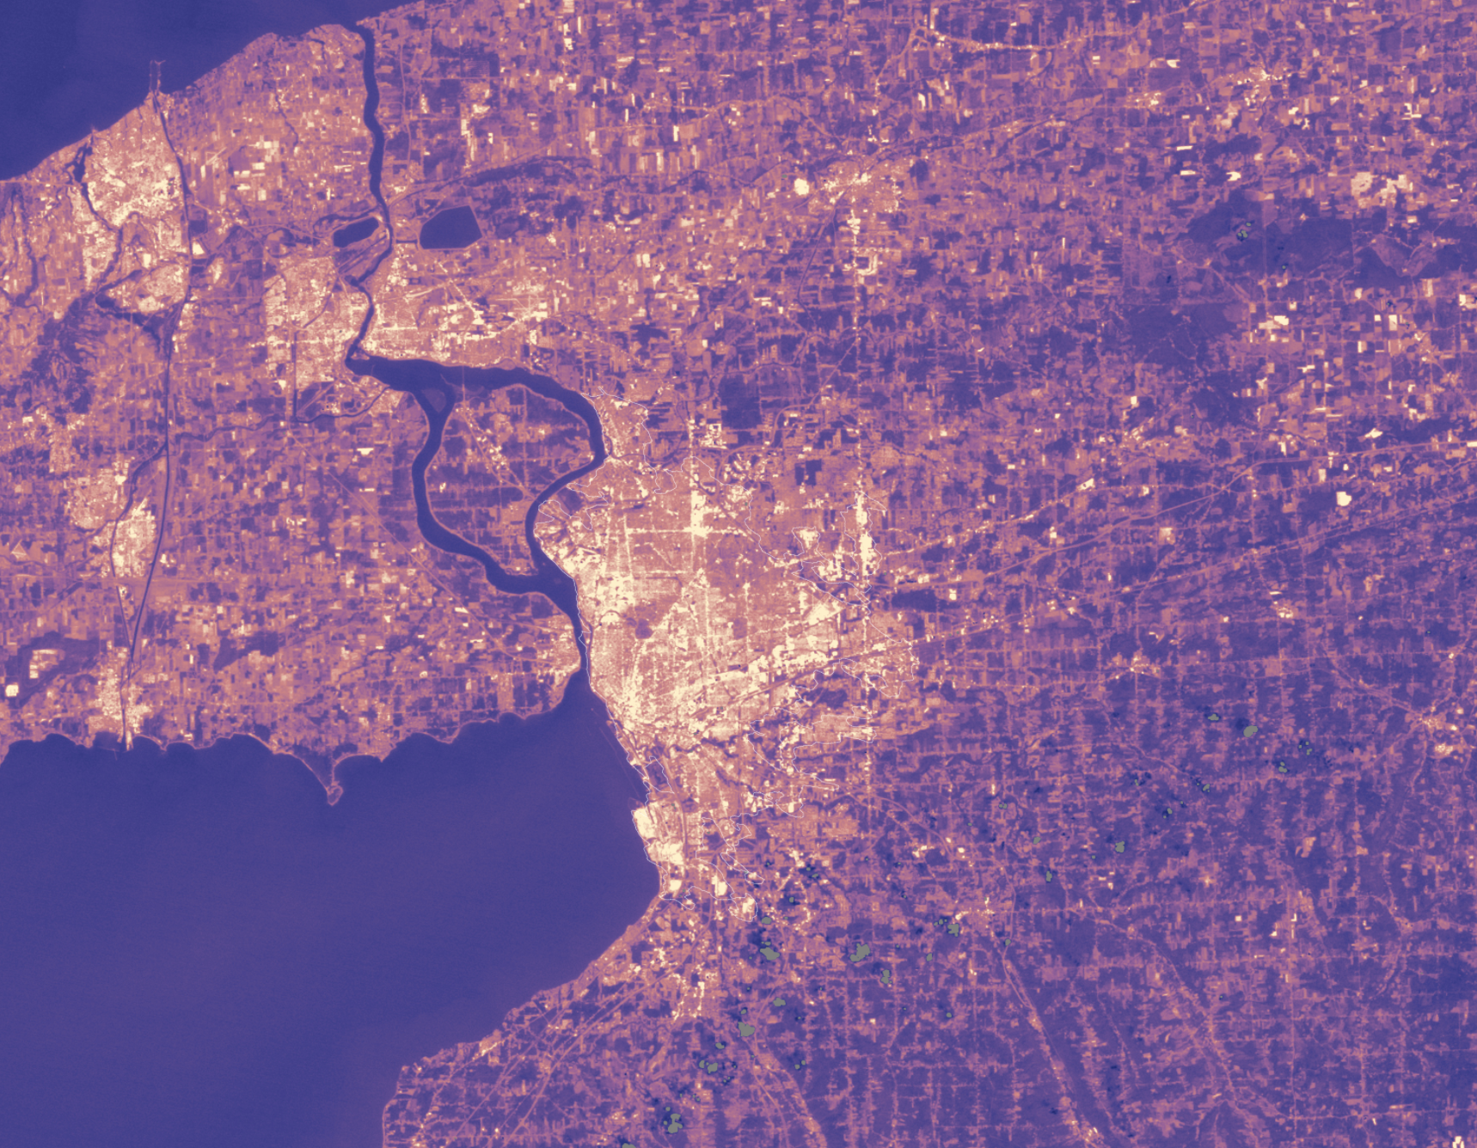
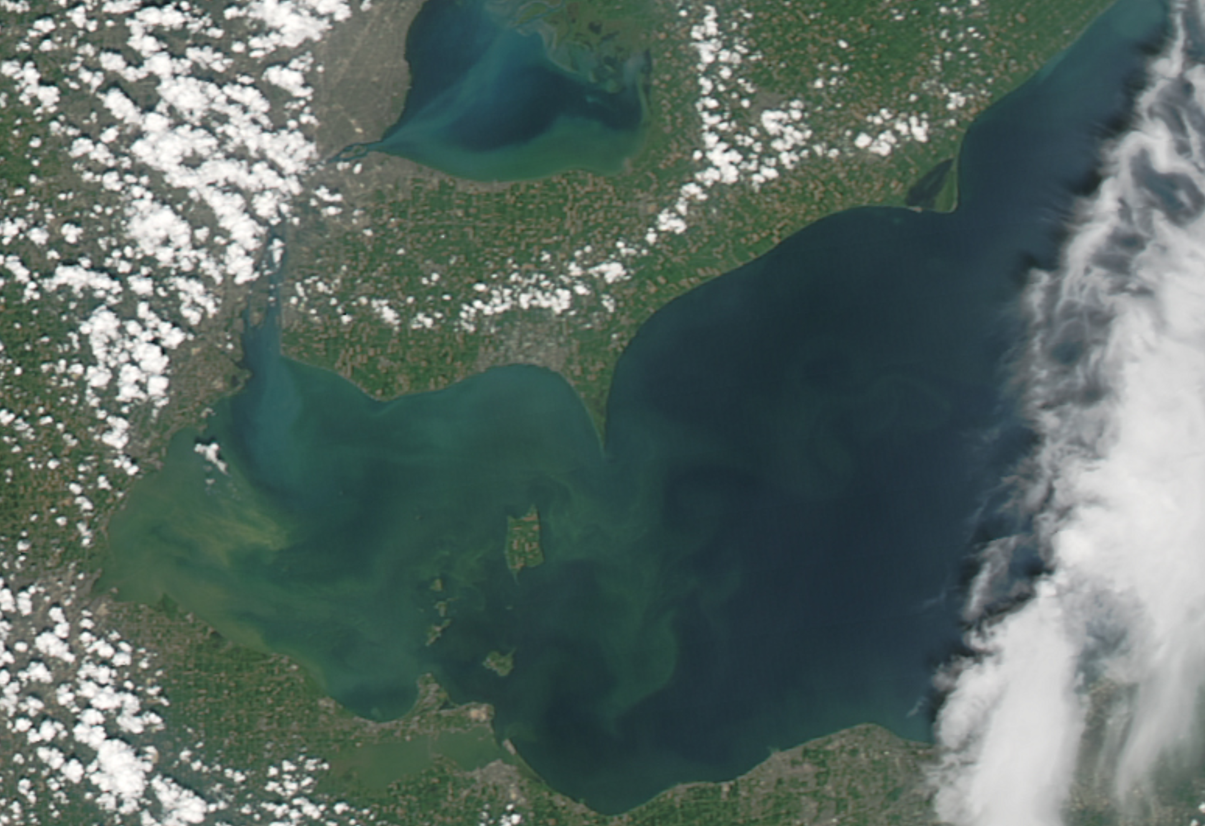
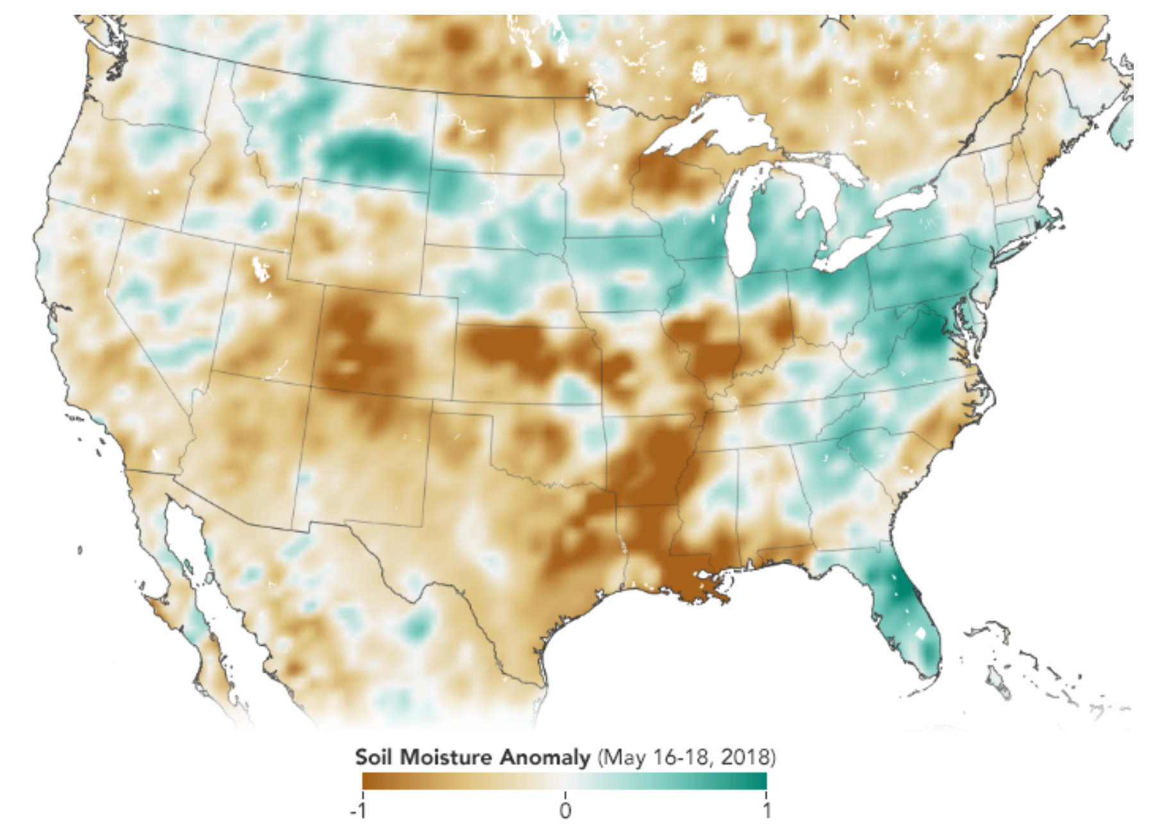
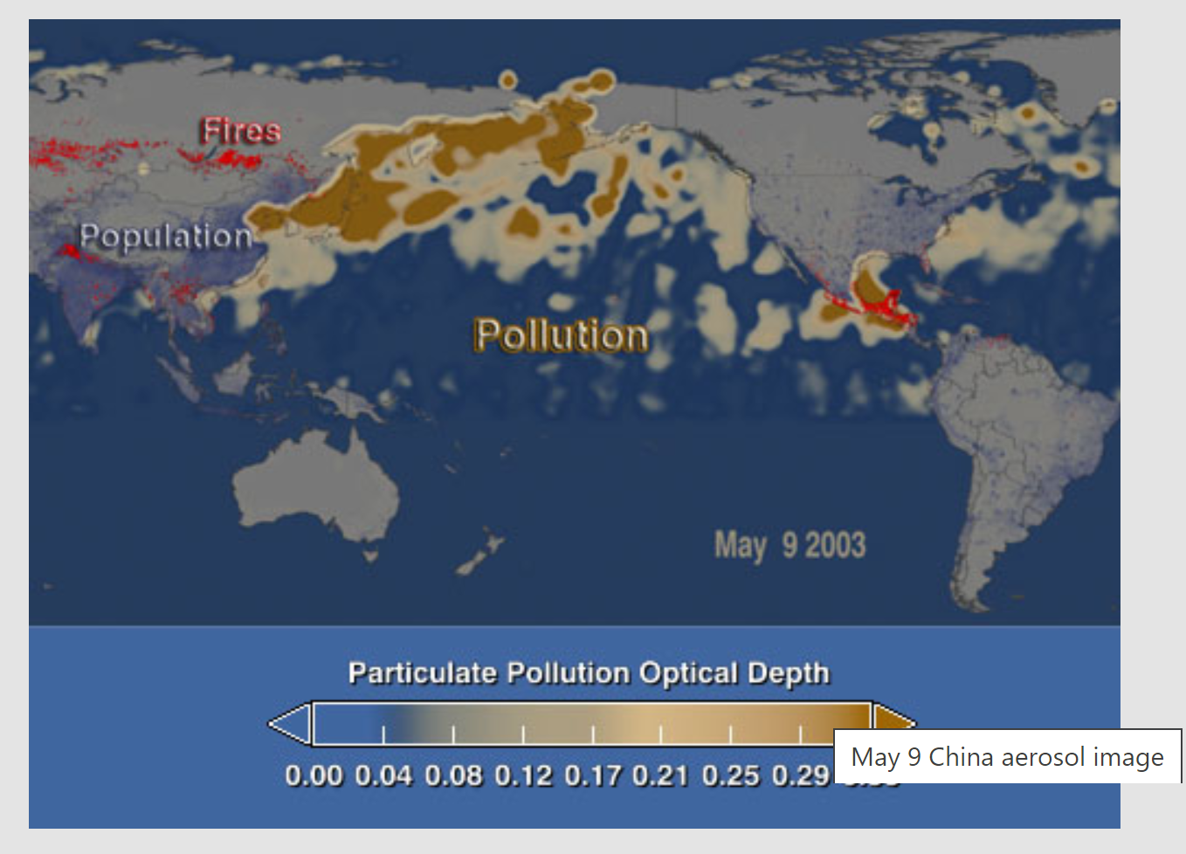
Urban surface temperature
Algae bloom mappping

Slide 6
Download Landsat data; Import data to Rstudio
Vegetation index (Normalized Difference Vegetation Index or NDVI)
Normalized Difference Water Index
Image classification (land cover mapping)

Slide 7
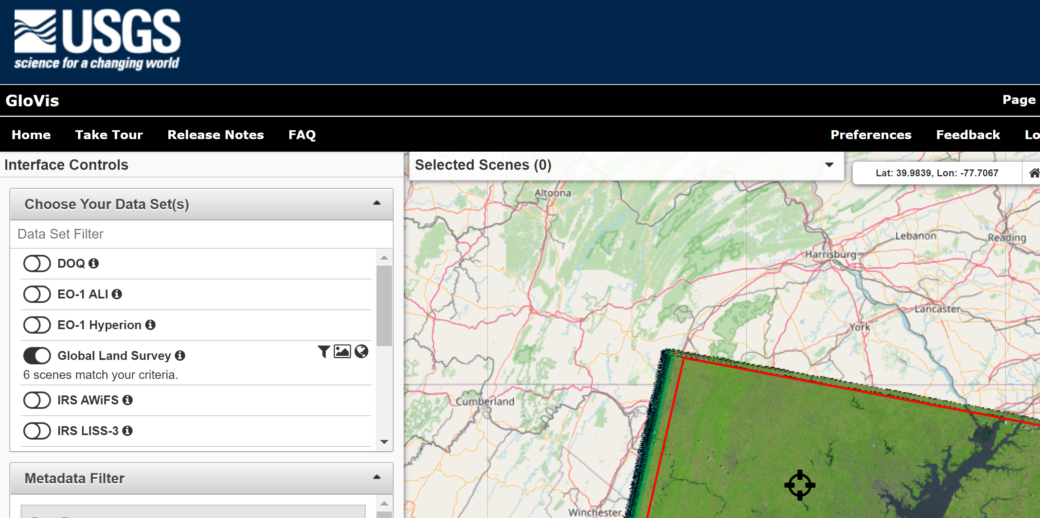
https://glovis.usgs.gov/app?fullscreen=0

Slide 8
Demo

Slide 9
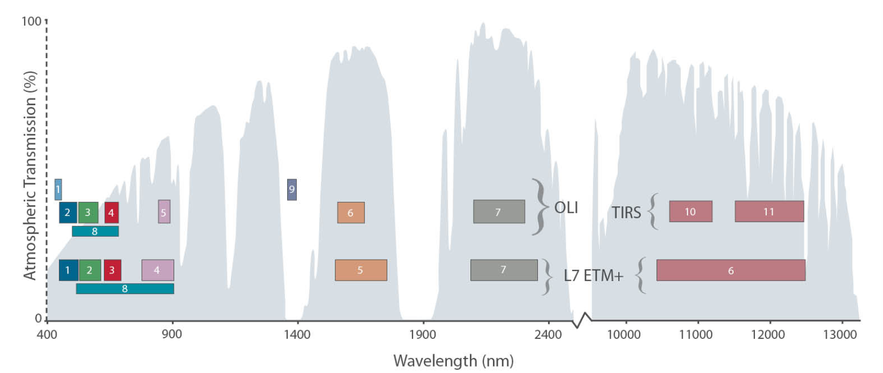
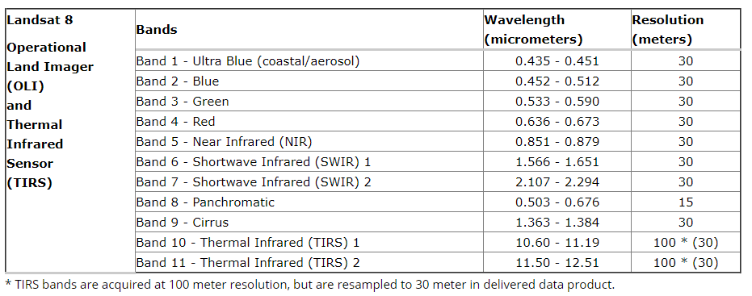

Slide 10
Download Landsat data; Import data to Rstudio
Vegetation index (Normalized Difference Vegetation Index or NDVI)
Normalized Difference Water Index
Image classification (land cover mapping)

Slide 11
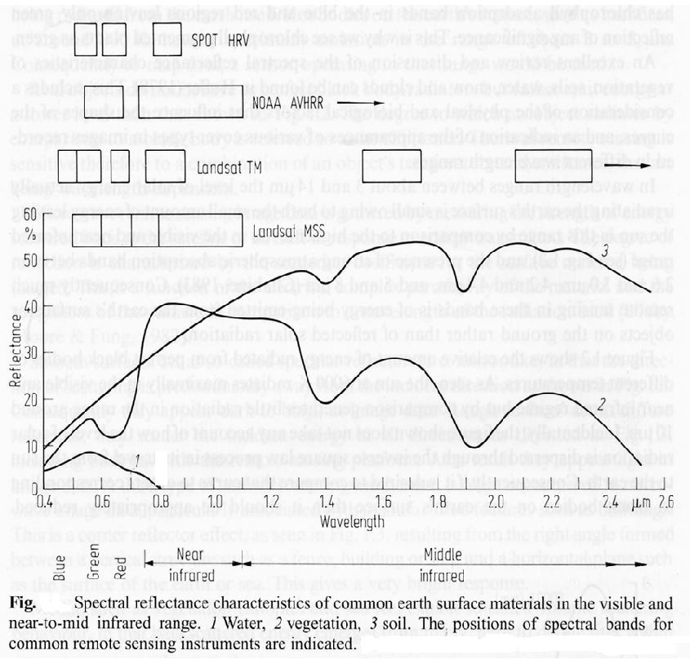
Vegetation Indices
Normalized Difference Vegetation Index (NDVI)
NDVI: [-1.0, 1.0]
Often, the more the leaves of vegetation present, the bigger the
contrast in reflectance in the red and near-infrared spectra.

Slide 12
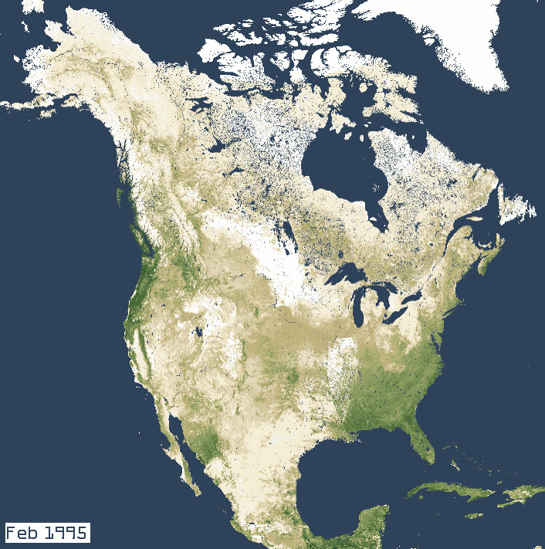
Normalized Difference Vegetation Index (NDVI)
NDVI =(NIR - R) / (NIR + R)
In Landsat 4-7, NDVI = (Band 4 – Band 3) / (Band 4 + Band 3)
In Landsat 8, NDVI = (Band 5 – Band 4) / (Band 5 + Band 4)

Slide 13
Normalized Difference Water Index
For Landsat 7 data,
NDWI = (Band 2 – Band 5) / (Band 2 + Band 5)
For Landsat 8 data,
NDWI = (Band 3 – Band 6) / (Band 3 + Band 6)

Slide 14
Download Landsat data; Import data to Rstudio
Vegetation index (Normalized Difference Vegetation Index or NDVI)
Normalized Difference Water Index
Image classification (land cover mapping)

Slide 15
Image classification approaches - computer-aided classification
Themes can vary (examples):
Urban, forest, ag, wetland, .. (NLCD)
Soil, vegetation, impervious surface, water
Computer algorithms (many)
- ML (Maximum Likelihood Classification)
- CART (Classification and regression trees)
- Random Forest Algorithm

Slide 16
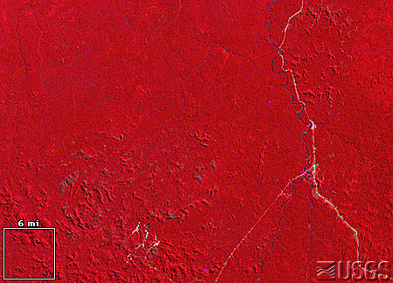
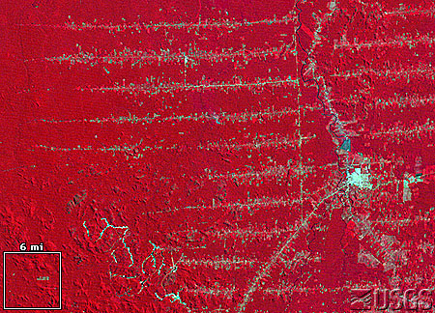
Image classification applications
Deforestation
Urban mapping and urban growth mapping
Coastal wetlands vegetation
Precision Agriculture
Identify invasive species
..

Slide 17
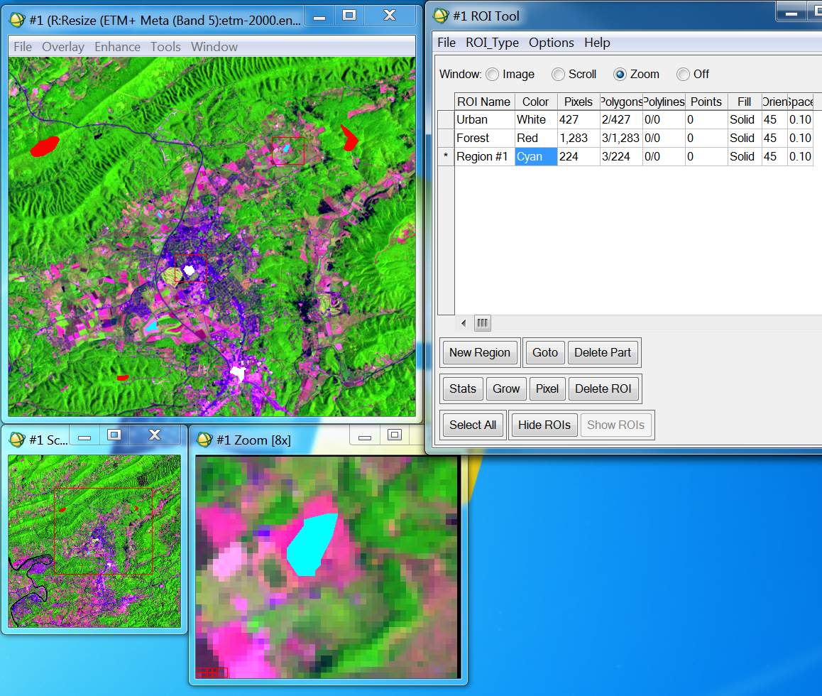
Supervised Classification Algorithms
Users provide the computer with some examples (training pixels)
of known features in multi-dimensional feature space.

Slide 18
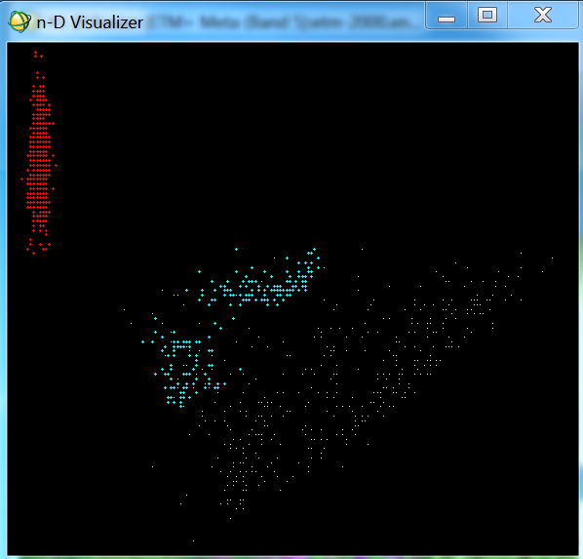
Supervised Classification Algorithms
Forest
Ag
Band 4
Generate statistics
for supervised classification
Urban
Band 3

Slide 19
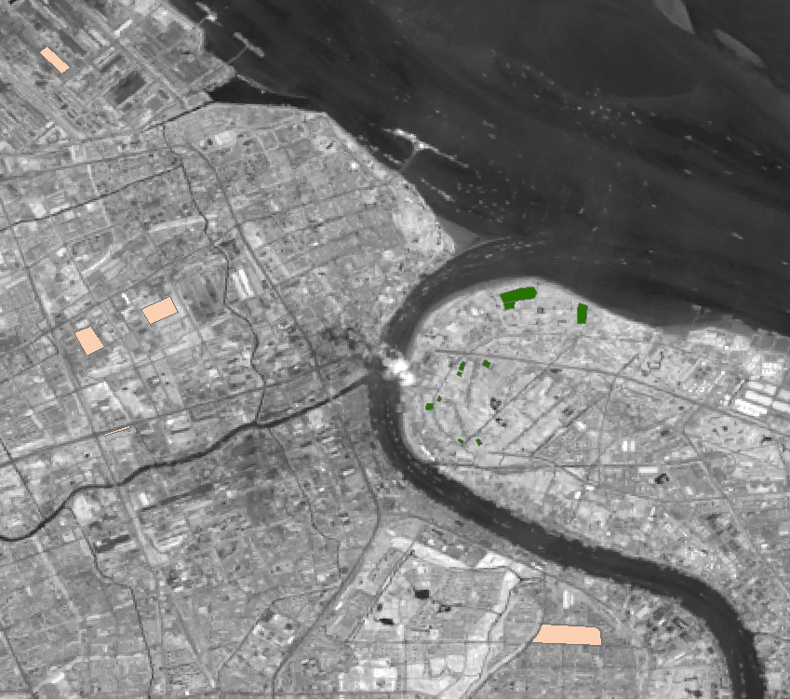
Twoclass.shp (urban and forest polygons)

Slide 20
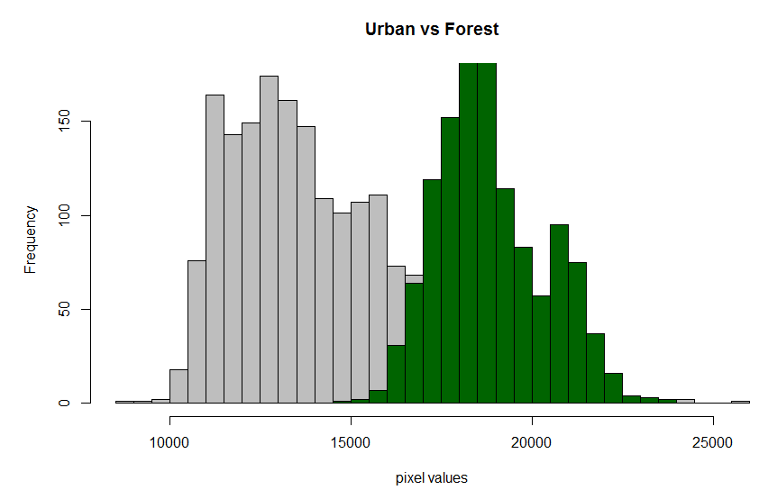

Slide 21
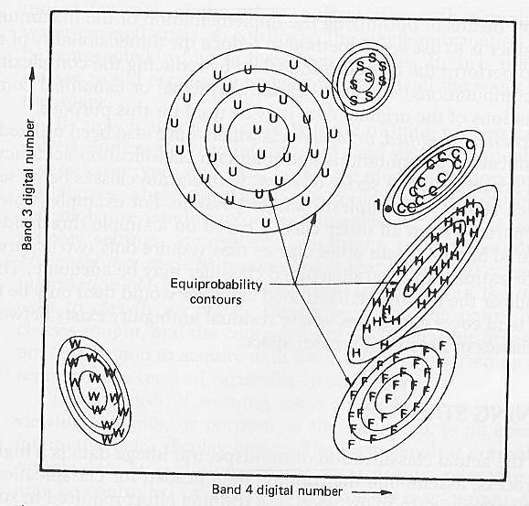
Maximum Likelihood Classification
In a two dimensional spectral space, each class form a probability density region,
the probability for a pixel belongs to a center category is defined by its distance
measured in standard deviation. The pixel is assigned a class that is most likely
(maximum likelihood).
Disadvantages: Large number of computations, particularly many spectral bands
are involved.

Slide 23
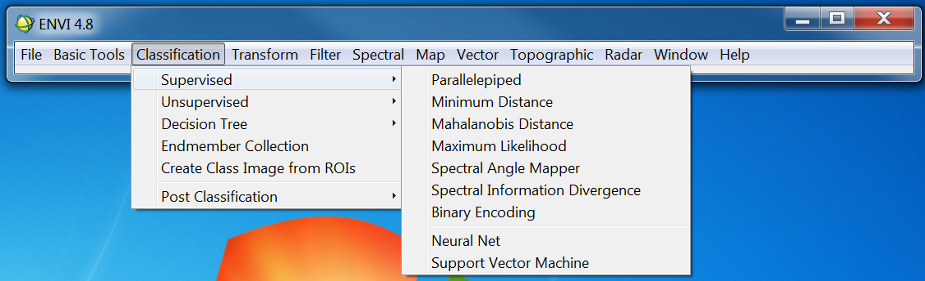
Supervised Classification Algorithms in ENVI

Slide 24
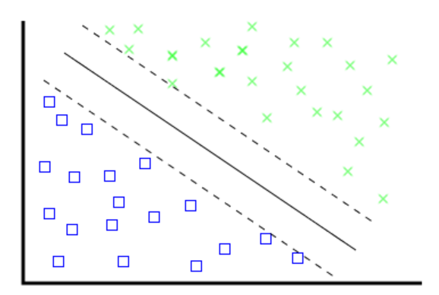
Test different image classification algorithms
Forest
Non-forest
Neural Networks
Classification and Regression Tree
Random Forest
Support Vector Machine
Weights
Weights
Band4
Band1
Band2
…．
Band3
Band4
Band4>95
Class1
Class2
Band3<50
CART
SVM

Slide 25
Image classification (land cover mapping)
Training data polygons (e.g., urban, forest, ag…)
Landsat image
Classcode (y) | Band3 (red) | Band4 (nir)
1 | 13000 | 15000
1 | 12500 | 18321
2 | 9800 | 4560
2 | 9832 | 4780
1 | 14500 | 19200
1 | . | .
1 | . | .
1 | . | .
1 | . | .
1 | . | .
1 | . | .
3 | . | .
3 | . | .
3 | . | .
1 | . | .
1 | . | .
Dataframe of training data
Y~ f(x)
(classification problem,not a regression)

Slide 26
Twoclass.shp (urban and forest polygons)

Slide 27
Make predictions for all pixels
Classcode (all pixels) | band1 | band2
? | 14000 | 12000
? | 13500 | 18521
? | 1900 | 3560
? | 4832 | 3780
? | 4500 | 9200
? | . | .
 | . | .
 | . | .
 | . | .
 | . | .
 | . | .
 | . | .
 | . | .
 | . | .
 | . | .
 | . | .
Y~ f(x)
(classification problem,not a regression)

Slide 28
Twoclass.shp (urban and forest polygons)

Slide 29
Rscript and demos

